Slide 1
Agile / Scrum
Lunch & Learn

Slide 2
What is Agile? What is Scrum?
Glossary of Terms
Sprint Overview
Sprint Flow (Detailed)
Useful Links

Slide 3
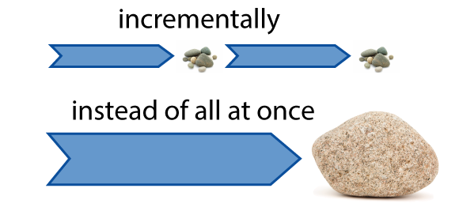
What is Agile?
What is Scrum?
Agile is an umbrella term that refers generally to a time boxed, iterative approach to software delivery that builds software incrementally from the start of the project, instead of trying to deliver it all at once near the end. It works by breaking projects down into little bits of user functionality called user stories, prioritizing them, and then continuously delivering them in short, one to four week cycles called iterations. There are many different
frameworks which a company can use to implement Agile best practices.
Scrum is one of the most popular ways to implement Agile, and the one chosen by most Ultra clients. In Scrum, iterations are called sprints, and they usually last two weeks. Scrum, like most Agile methods, favors cross functional teams. There are no formal titles or roles on Scrum projects (save Scrum Master and Product Owner). People still have their areas of specialization (tester, analyst, developer), but the expectation is that people work outside of traditional narrowly defined titles or roles and do whatever it takes to make the project a success.

Slide 4
What is Agile? What is Scrum?
Glossary of Terms
Sprint Overview
Sprint Flow (Detailed)
Useful Links

Slide 5
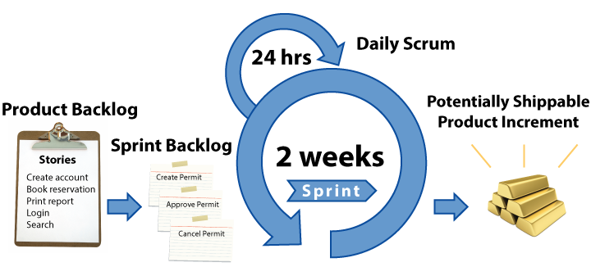
Sprints
The sprint is the Scrum version of an Agile iteration. This is the two week period where the team gets stuff done. Scrum likes to call the output of a sprint the “Potentially Shippable Product” to remind us that this is production ready stuff and we could ship it if we had to.
Scrum sprints don't have to be two weeks in length. In fact, the original Scrum sprint was 30 days. But most teams found this too long, and two weeks seems to be about right for most teams.

Slide 6
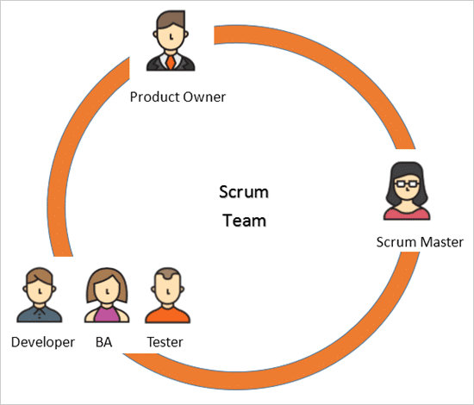
Roles
Role Name | Description
Product Owner | Provides vision for the software to be built. Product Owner not only focuses on the work to be completed but also focuses on business and market requirements. The PO interacts with the team as well as other stakeholders to build and manage the backlog. The role of a PO is to motivate the team to align them with the goal and vision of the project.
Scrum Master | Scrum Master helps the team reach optimal performance by watching the overall Scrum process. They facilitate, monitor and make recommendations, ensuring the team is consistently delivering shippable product. Like a Project Manager, they shelter the team from outside distractions, but mostly they get out of the way, play a servant leader type role, and help the team focus on that sprint’s user stories.
Scrum Team | The Scrum Team can be typically comprised of 5 to 7 members, including Dev / QA. Roles and responsibilities do not matter as much as results: a developer may test, perform analysis or think about requirements; an analyst or domain expert can suggest ideas about implementation, and so on.

Slide 7
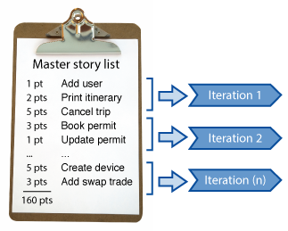
Backlogs
Product Backlog: The Product Backlog is the to do list for the project. It contains a list of all the features the Product Owner would one day like to see in their software. It’s prioritized, estimated, and what the team draws from when deciding what to do in a iteration or sprint.
Sprint Backlog: What the team commits to each sprint is tracked in a Sprint Backlog. It contains a list of user stories the Product Owner would like to see developed for that sprint.
While the Product Backlog identifies ALL of the pending features of the product being developed, the Sprint Backlog identifies only that smaller list of Product Backlog items which have been jointly agreed between the product owner and the team as goals to be accomplished during the current sprint.

Slide 8
Meetings
Meeting Name | Frequency | Length | Participants
Grooming | Once per sprint - prior to start of sprint | 4 hours or less | Product Owner, Leads
Sprint Planning | Once per sprint - Day 1 | 4 hours or less | Full Team
Daily Stand Up | Daily (except first day of sprint) | 15 minutes or less | Full Team
Sprint Review (“Demo”) | Once per sprint - last day of sprint | 2 hours or less | Product Owner, Leads
Sprint Retrospective | Once per sprint - after sprint closes | 1.5 hours or less | Full Team

Slide 9
Scrum Meetings
Backlog Grooming Meeting: The Product Owner, Scrum Master, and other key players will use this time to help create or review emergent product backlog items, as well as progressively refine larger items into smaller items. The team will also estimate the size of product backlog items and help the Product Owner prioritize those items based on technical dependencies and resource constraints.
Sprint Planning Meeting: The Product Owner leads the first part of the meeting; they explain the vision for the features as well as ways for the team to meet this goal. During this meeting, team members decide the amount of work they can complete in a timely manner. The team moves work from the Product Backlog to the Sprint Backlog. Questions around the details of the features will be addressed during this meeting, work is broken down, and estimates put against the work.
Daily Stand Up (“Daily Scrum”): These are held daily, the full team participates, and they should be timeboxed to 15 minutes or less. The team uses this time to report any issues or progress on their tasks using the format, 1) What I did yesterday 2) What I plan to do today 3) Call out any blockers. Normally the Product Owner is present during all daily scrum meetings to assist in any way. Sprint Review Meeting (“Demo”): This meeting is used to showcase a live demonstration of the work completed. During this meeting the Product Owner, Scrum Master, and stakeholders are present to review the product and suggest changes or improvements, which will go into the backlog.
Sprint Retrospective Meeting: This meeting is held to facilitate a team’s reflection on their progress. The team speaks openly about their organizational concerns and teamwork. During this meeting, dialogue should remain friendly, non-judgmental, and impartial. This review session is a key part of team building and development, and it’s also very important for future scrum projects.

Slide 10
What is Agile? What is Scrum?
Glossary of Terms
Sprint Overview
Sprint Flow (Detailed)
Useful Links

Slide 11
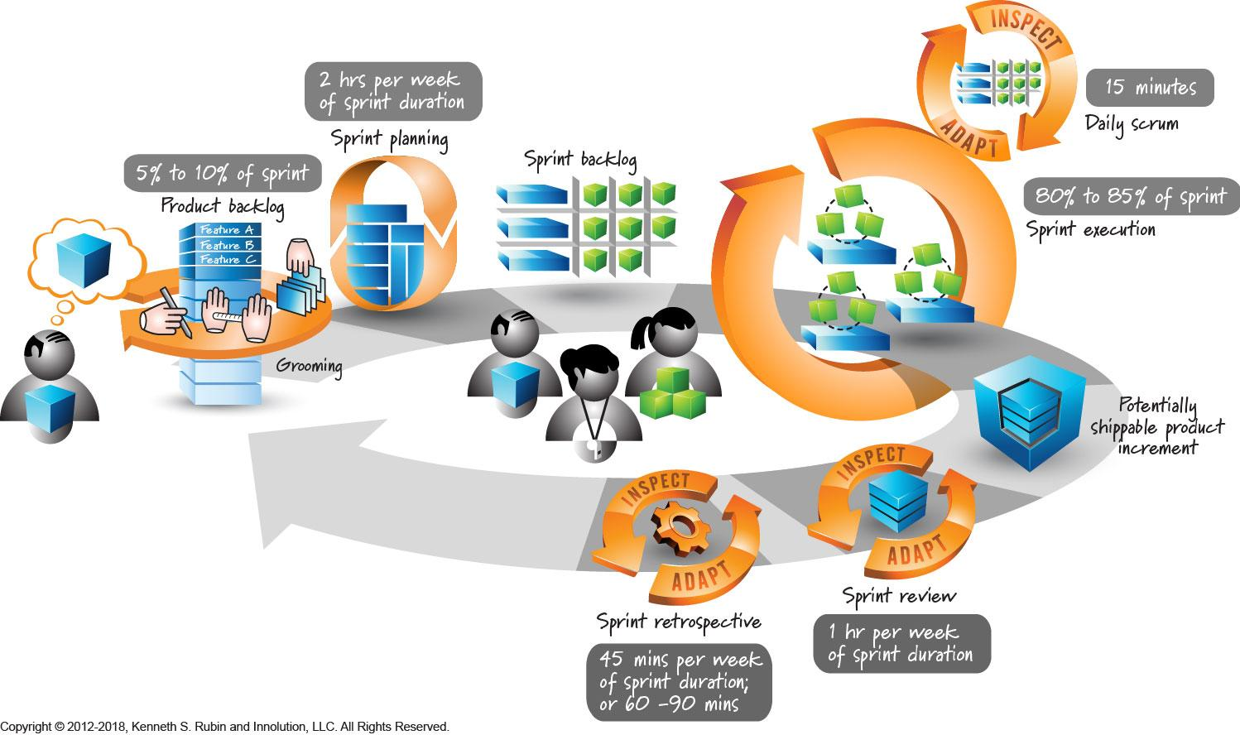
Sprint Cadence

Slide 12
Keys to Successful Sprints
Groomed Backlog
Appropriately sized user stories
Clear goals e.g. Definition of Done
Know your capacity - build in time for meetings / bug fixing
Get your team to commit to the process
Don’t carry tech / bug debt

Slide 13
What is Agile? What is Scrum?
Glossary of Terms
Sprint Overview
Sprint Flow (Detailed)
Useful Links

Slide 14
Handoff to Dev:
Product Owner Confirms Acceptance Criteria, Client Approved Specification, and Design / Breakpoints
Developer Has Reviewed and Accepted Story and is Ready to Begin Development

Slide 15
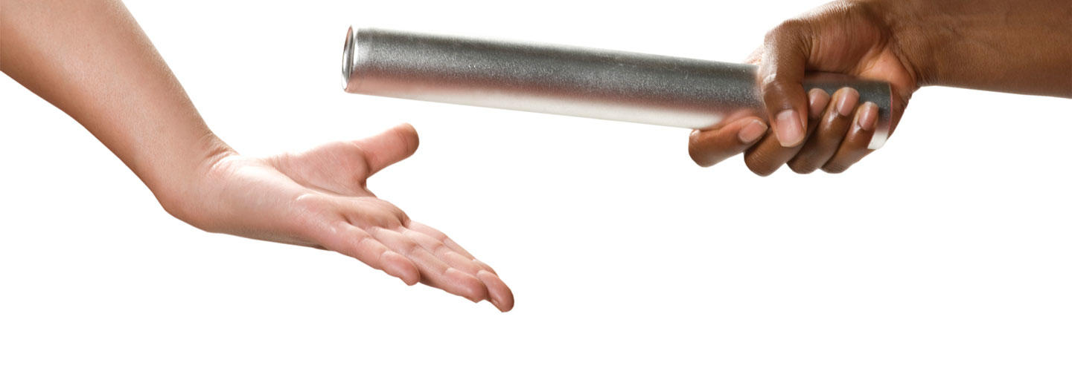
Handoff to QA:
Developer Validates All Acceptance Criteria on a Selection of Configurations in the QA Environment

Slide 16
Bug Guidelines
Log all issues that are found (these go into the Sprint Backlog initially, but may be moved to Product Backlog if deemed not critical for the current sprint)
Associate bugs with parent User Story for traceability
Regularly review bugs (triage daily if possible)
If something is not a true bug, recategorize - Improvements, Change Requests
Don’t build bug debt - if an issue is never going to be addressed, close it out
Factor bug fixing time into your sprint capacity -
e.g. 80% new feature development vs 20% bug fixing

Slide 17
Ready for Sprint Review:
QA Team Completes All Testing and Validates Acceptance Criteria on All Supported Configurations
No High Priority Bugs Open in the QA Environment

Slide 18
Definition of Done
Story is dev complete
Story passes functional tests on all supported configurations
Story passes non-functional tests (e.g. performance, security)
High priority bugs have been addressed
Story integrates with the existing code base
Product owner has approved the story
Supporting documentation is complete

Slide 19
Sprint Wrap Up
All targeted stories for the sprint are completed (have met the “Definition of Done” OR have been moved out to a future sprint)
All planned testing has been completed to an acceptable pass rate
No open high priority bugs
No remaining open User Stories, Tasks, or Sub Tasks
TIME FOR LAUNCH TO PRODUCTION!

Slide 20
What is Agile? What is Scrum?
Glossary of Terms
Sprint Overview
Sprint Flow (Detailed)
Useful Links

Slide 21
Useful Links
Agile Manifesto: https://agilemanifesto.org/
Scrum Guide: https://www.scrumguides.org/docs/scrumguide/v1/scrum-guide-us.pdf
Scrum Alliance: https://www.scrumalliance.org/
Agile Alliance: https://www.agilealliance.org/
Agile In a Nutshell: http://www.agilenutshell.com/

Slide 22
Q & A
Thanks!

